Slide 1
SQL for DS

Slide 2
Data : Data is a collection of facts in the form of words, numbers, or even pictures. Database: it is a data repository which provides functionality for adding, modifying, deleting and querying data.Available in different kinds and forms. Mainly SQL & NoSQL 5 Basic SQL commands: CREATE a table, INSERT, SELECT, UPDATE, DELETE SELECT: A DML statement used to read and manipulate data. SELECT * FROM table;

Slide 3
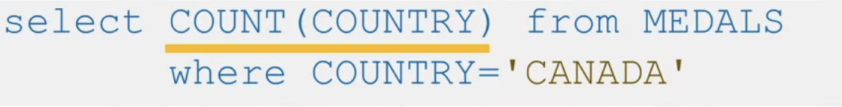
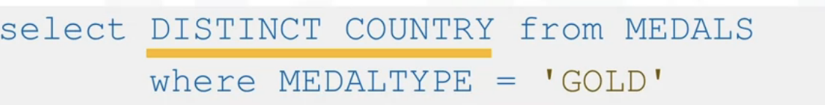
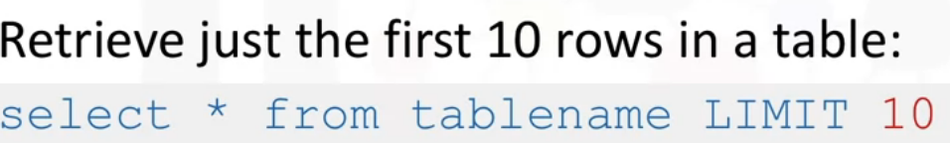
Count: retrieves number of rows matching the query criteria Distinct: removes duplicate values from a result set. Limit: limits number of rows retrieved from the database.

Slide 4
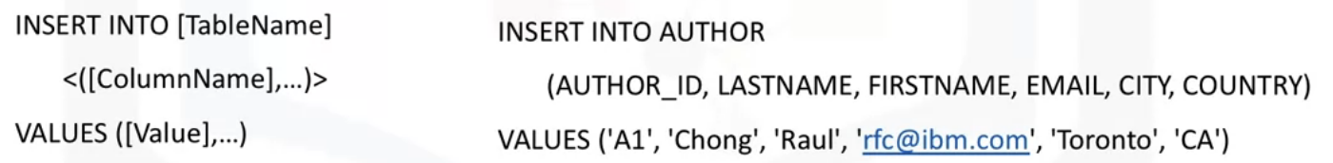
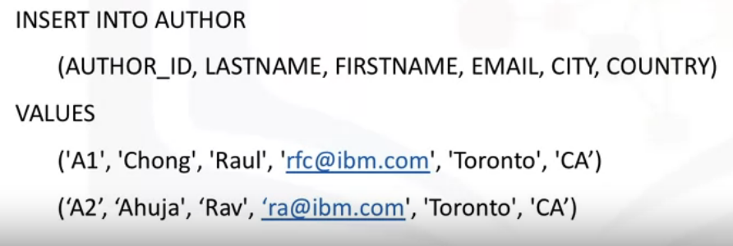
Insert Statement: A DML statement used to read and modify data
Inserting a single row
Inserting multiple rows

Slide 5
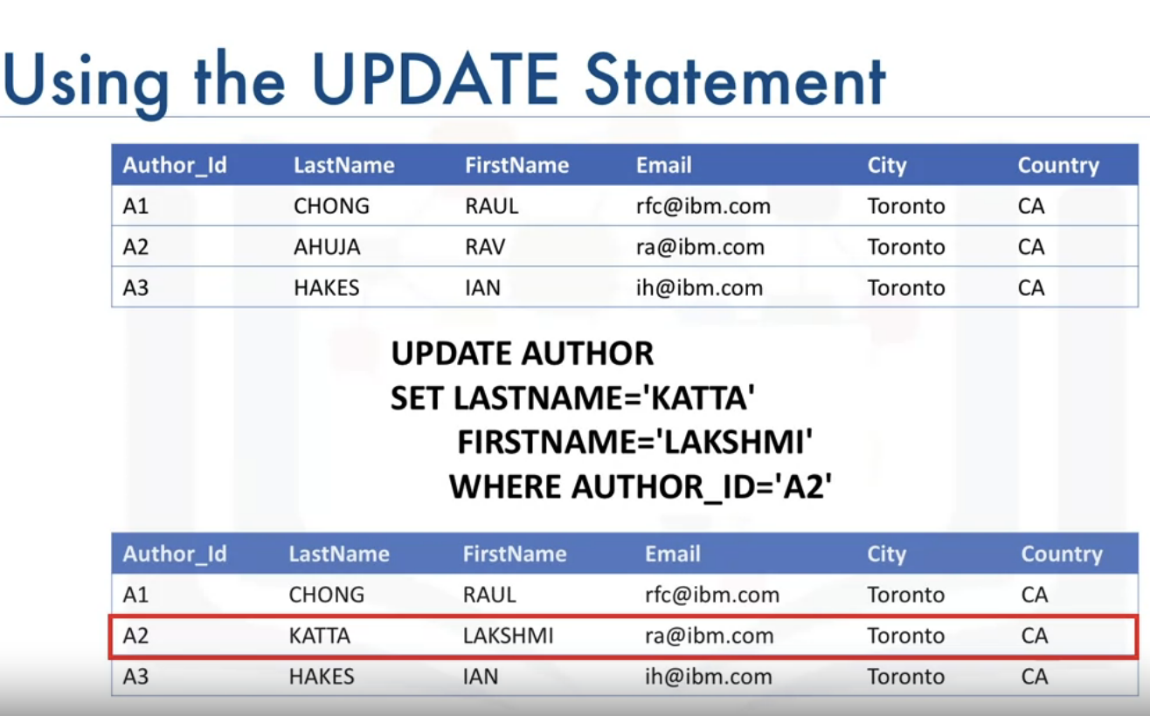
Update & Delete Statements
Update: A DML statement used to read and modify data
If we do not specify ‘WHERE’ , all the rows will be updated

Slide 6
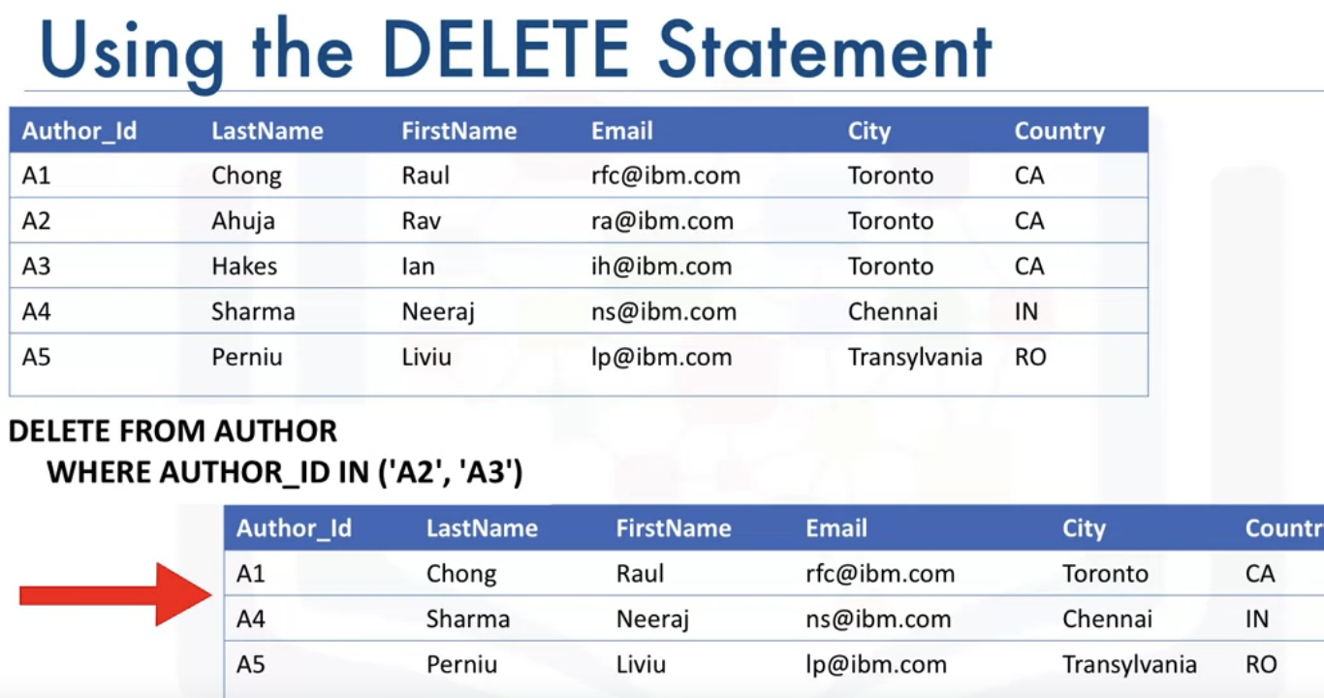
If we do not specify ‘WHERE’ , all the rows will be deleted.

Slide 7
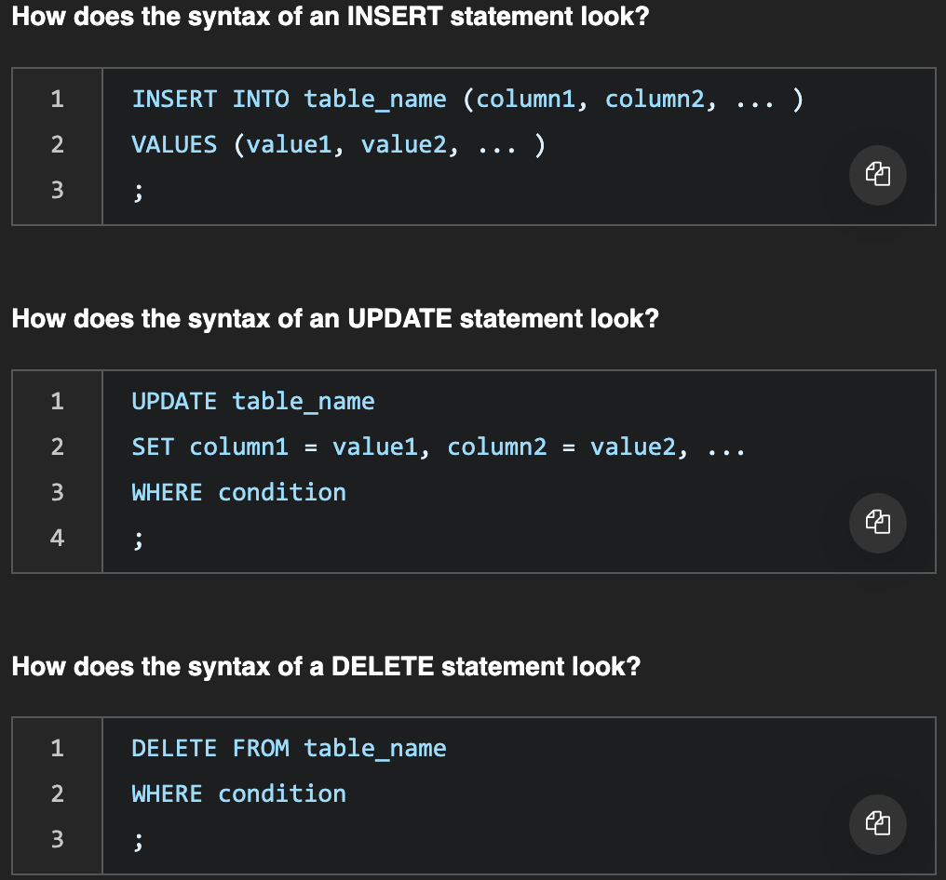
INSERT, UPDATE, DELETE syntax

Slide 8
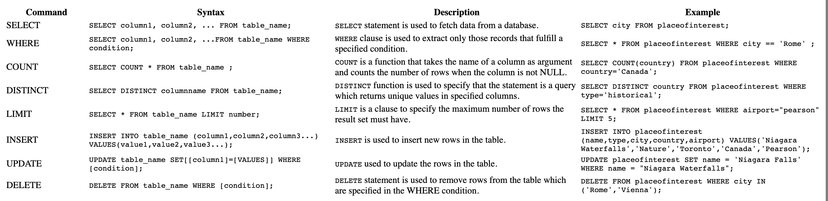

Slide 9
DDL: Data Definition Language Statement: Define, Change or Drop Data Common DDL: CREATE: used for creating tables and defining its columns ALTER: is used for altering tables including adding and dropping columns and modifying their datatypes TURNCATE: is used for deleting data in a table but not the table itself; DROP: is used for deleting tables. Data Manipulation language (DML): Read and Modify data using CRUD (CREATE, READ, UPDATE, DELETE - ROWS) operations Common DML: INSERT: is used for inserting a row or several rows of data into a table; SELECT: reads or selects row or rows from a table; UPDATE: edits row or rows in a table; DELETE: removes a row or rows of data from a table.
Types of SQL Statements : DDL Vs. DML

Slide 10
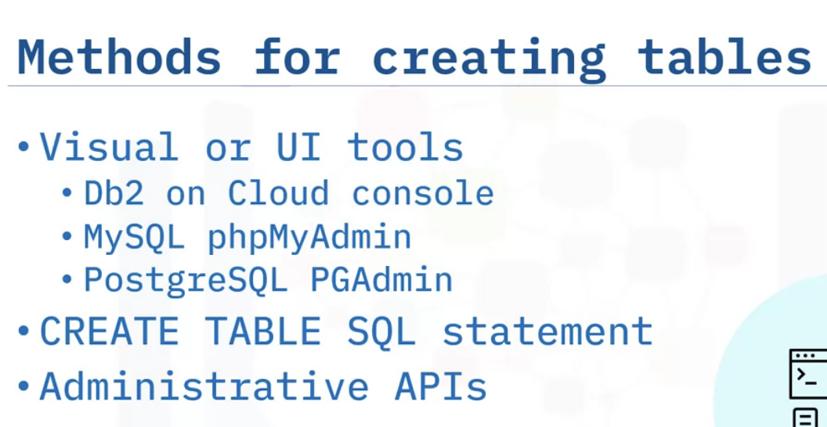
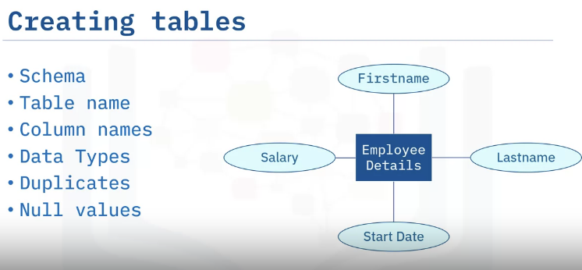
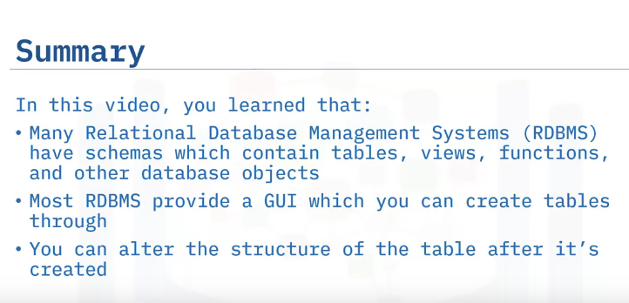
Creating Tables
Considerations for creating tables
How to create a table in a graphical interface like DB2 on cloud
How to alter table structure after creation

Slide 11
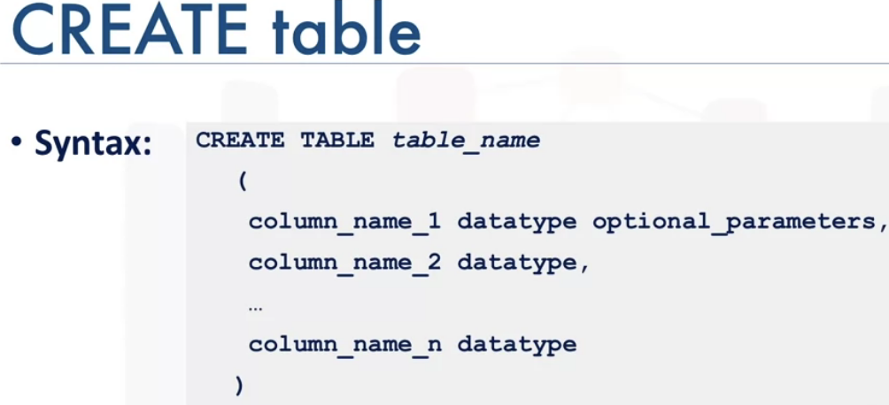
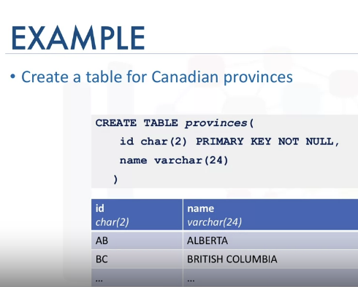
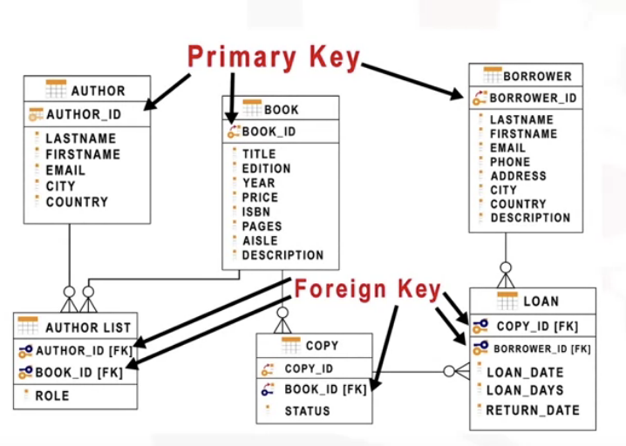
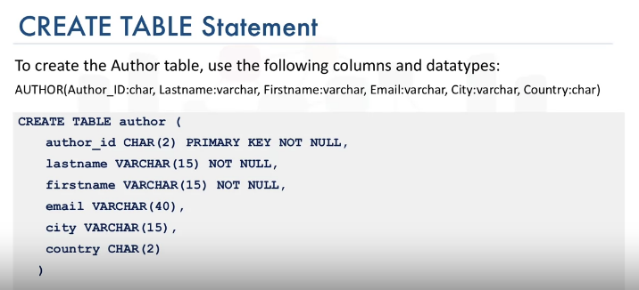
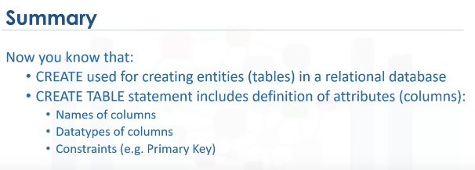

Slide 12
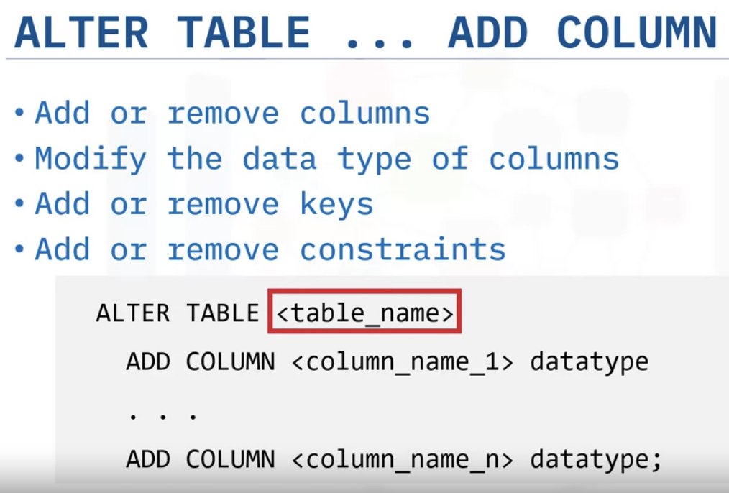
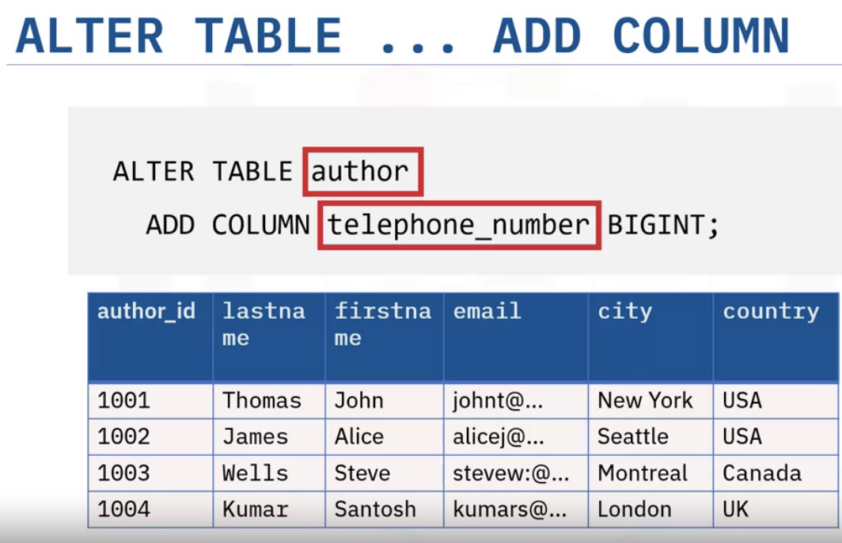
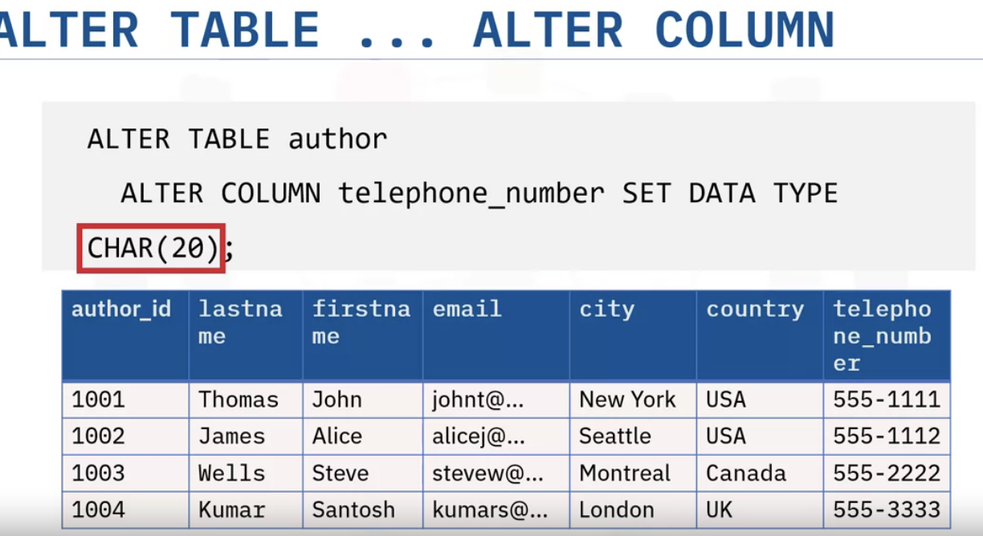

Slide 13
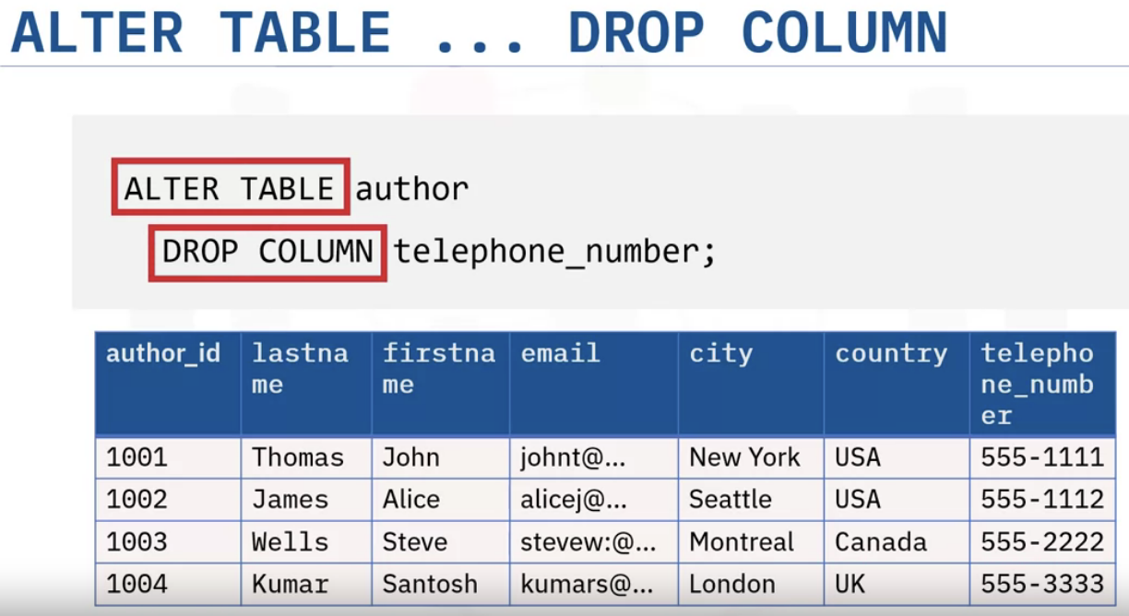
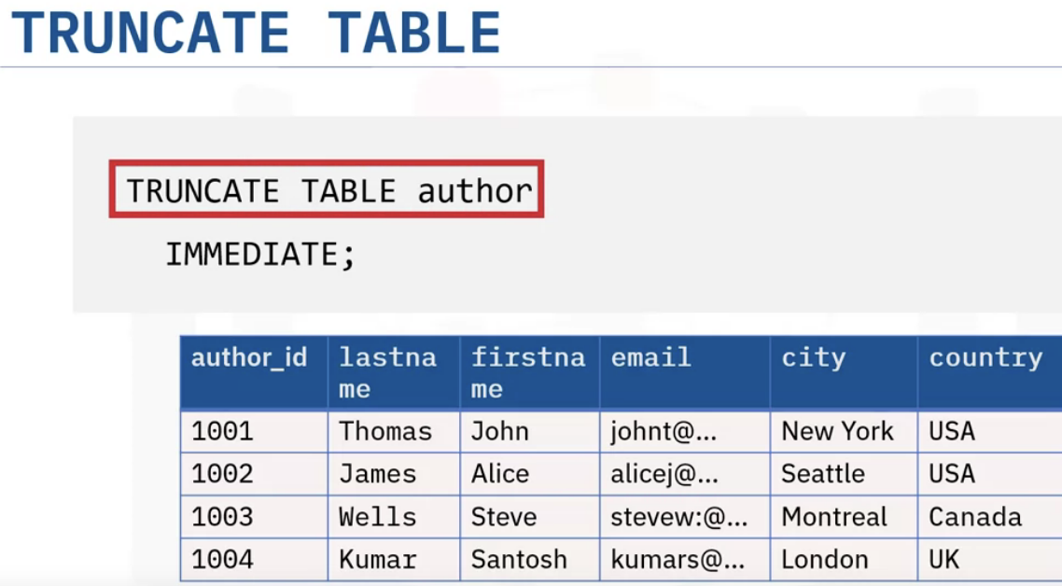
Table will remain as it is, but all the rows will be deleted.
Changes- column will be dropped.

Slide 14
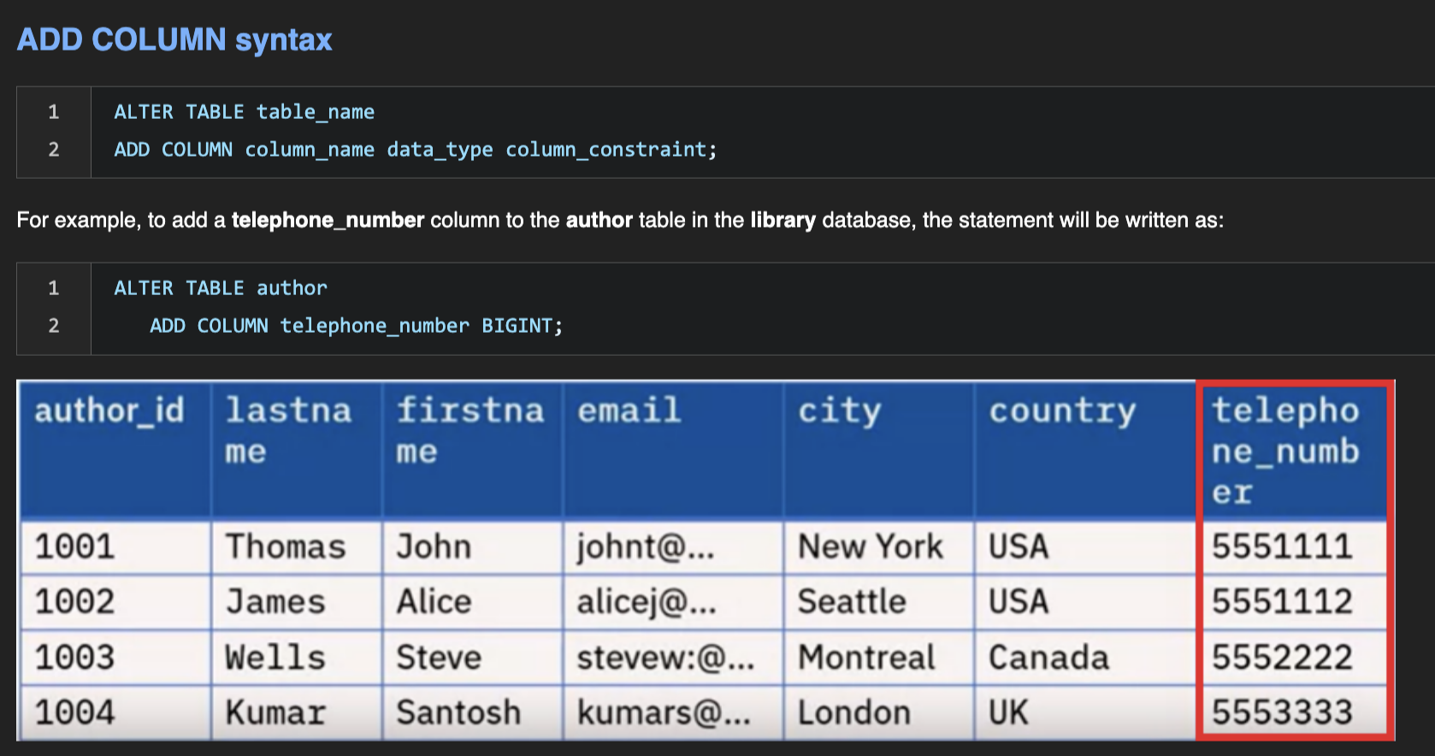

Slide 15
